Slide 1
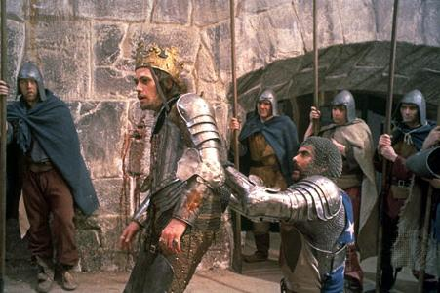
MacBeth, Act 1
By William Shakespeare
Jeff Kamovitch
Grade 10 - 2010
Click Hither to Begin

Slide 2
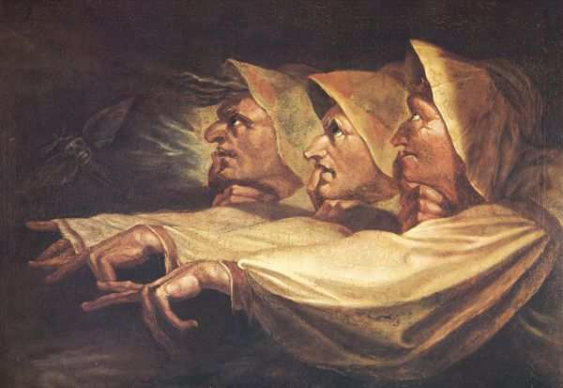
MacBeth, Act I
Scene I
In the beginning of the play, three witches discuss the settings for the inevitable meeting with MacBeth. They agree upon dastardly settings, questioning if the setting is best in lightning, thunder, or rain.
Romantic-era artist Henry Fuseli painted a
famous portrait of the three witches based on
their MacBeth portrayal.
What is meant by “Foul is fair and fair is foul?”
To Title Page
To Scene II

Slide 3
MacBeth, Act I
Scene II
King Duncan hears a sergeant’s tale of how MacBeth Saved him in battle. Duncan, in turn, grants MacBeth the honor of the Thane of Cawdor. The scene ends as Duncan sets out the Thane of Ross to inform MacBeth of his new title.
Today, Cawdor is known for it’s fourteenth-century castle, which is thought to be the inspiration for Shakespeare’s reference in MacBeth. For more on Cawdor Castle and the history of the Thane of Cawdor title, visit Castles.org’s Cawdor Castle page.
To Scene I
To Scene III

Slide 4
MacBeth, Act I
Scene III
The witches prophesize to MacBeth that he will be king, and the children of his friend, Banquo, will become Kings thereafter. They address him as the Thane of Glamis, which is true, and the Thane of Cawdor, which MacBeth is not yet aware of. When addressed as so, he dismisses it as the Thane of Cawdor is alive and well, and King appears to be a long shot.
Ross and Angus appear and confirm the witches’ prophecy: Duncan has assigned MacBeth the title Thane of Cawdor. In disbelief, Banquo and MacBeth converse about the strange circumstances which have taken place.
Here is this scene from Roman Polanski’s adaptation of MacBeth.
Take note that prior to their engagement with the witches, MacBeth takes note to Banquo of the ‘foul and fair’ weather.
To Scene II
To Scene IV

Slide 5
MacBeth, Act I
Scene IV
Duncan hears the news of the previous Thane of Cawdor being executed for rebellion. MacBeth arrives at his court, and Duncan is enthusiastic to crown him to his new title.
The story takes a twist, however, when Duncan heralds Malcolm as heir to the throne. MacBeth then leaves to go tell his wife of the recent news.
Interestingly enough, Duncan was an actual King, and MacBeth was actually one of his army commanders.
To Scene III
To Scene V

Slide 6
MacBeth, Act I
Scene V
Lady MacBeth evaluates MacBeth’s letter chronicling his account with the witches. MacBeth arrives and announces that King Duncan is coming to dinner. She thereupon tries to motivate MacBeth and subliminally set his frame of mind to hers, as she wants to instantly inherit the throne. MacBeth tells her that they’ll talk more about it later.
What does MacBeth think of Lady MacBeth’s swooning?
Is the last line, “Leave all the rest to me” foresight for things to come?
To Scene IV
To Scene VI

Slide 7
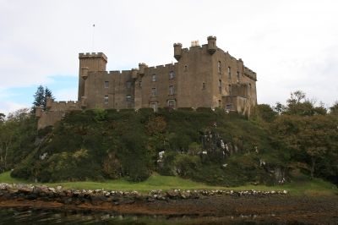
MacBeth, Act I
Scene VI
Duncan arrives at MacBeth’s castle with his court and Lady MacBeth accommodates them. Duncan asks to see MacBeth and Lady MacBeth dodges the question.
To Scene V
To Scene VII

Slide 8
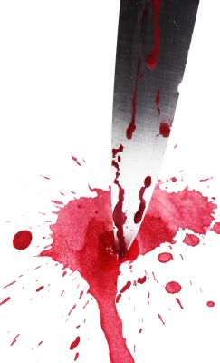
MacBeth, Act I
Scene VII
Lady MacBeth persuades MacBeth to kill Duncan. At first, MacBeth is extremely hesitant and questions her rationale. With more persuasion throughout the night, MacBeth finally commits to killing the king.
To Scene VI
To Exeunt

Slide 9
MacBeth, Act I
Review & Credits
Who was Present in the Act I?
What key events occur?
MacBeth
Lady MacBeth
Duncan
Malcolm
Banquo
Donalbain
The Witches
Lennox
Ross
The Witches alert MacBeth
MacBeth crowned Thane of Cawdor
Lady MacBeth plots to kill Duncan
Lady MacBeth persuades MacBeth to kill Duncan
Resources:
IMAGES
Slide 1 – MacBeth - found @ http://www.lehman.cuny.edu/deanedu/litstudies/myclasssite/webroot/pmclass/e701/jumuat/duncan.htm - lehman@cuny.edu
Slide 2 – The Weird Sisters – found @ http://www.lehman.cuny.edu/deanedu/litstudies/myclasssite/webroot/pmclass/e701/jumuat/duncan.htm - lehman@cuny.edu
Slide 7 – Dunvegan Castle, Scotland, found @ http://www.freedigitalphotos.net/images/Scotland_g84-Dunvegan_Castle_p575.html (Free use image site)
Slide 8 –Knife in Blood, found @ http://www.freedigitalphotos.net/images/Uncategorised_g43-Knife_In_Blood_p6696.html (Free use image site)

